Slide 1
MILK CRATE TRACKING USING RFID

Slide 2
CUSTOMER REQUIREMENTS
CUSTOMER NEED TO TRACK THE CRATE AFETR THE PRODUCTION
FILLED CRATES ARE STACKED INTO THE VEHICLES FOR SUPPLY BEFORE THEY NEED A PHYSICAL VERIFICATION
THEY NEED TO TRACK THE HOW MANY CRATES RETURN BACK OR MISSING
PORTABLE TYPE OF READERS REQUIRED

Slide 3
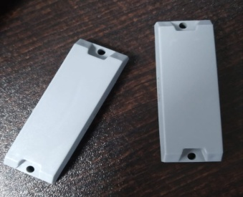
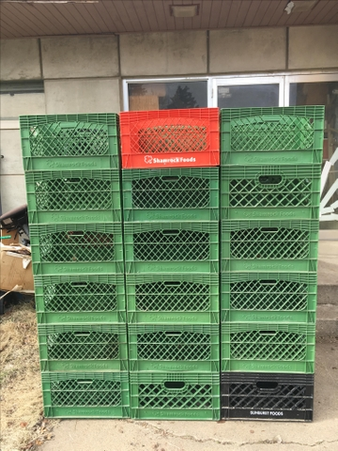
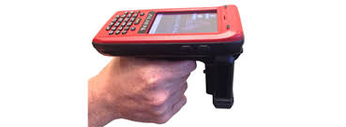
PROCESS FLOW
RIFID HARD TAGS ATTACHED INNTO EACH CRATE
((((
PORTABLE READER WITH PROGRAMME TO CHECK THE CRATE NUMBER

Slide 4
CHALLENGES
MILK FILLED CRATE ARE FILLED INTO FROZEN CHAMBER AROUND -20 TAG WIDSTANDABLE TAG REQUIRED
HARD TAG REQUIRED FOR THIS OPERATION
CURRENTLY THEY ARE NOT USING ANY KIND OF SOFTWARE

Slide 5
ADVANTAGES
REMOVE ERROR IN COUNTING
FIND THE MISSING CRATE (IN HOUSE)

Slide 6
PRODUCTS USED
ALIEN H 450 READER
ARMADA TAG

Slide 7
THANK YOU
PRESENTED BY:PRAMOD C
CUSTOMER NAME:SABARI MILK PRODUCTS

